Slide 1
Data Structures & Algorithms (CSC-214)
Recursion

Slide 2
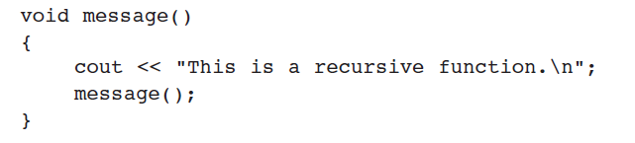
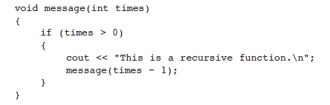
Recursion – Example (1)
Recursion is a programming technique where a function calls itself to solve smaller instances of the same problem.
A function that calls itself is called a recursive function

Slide 3
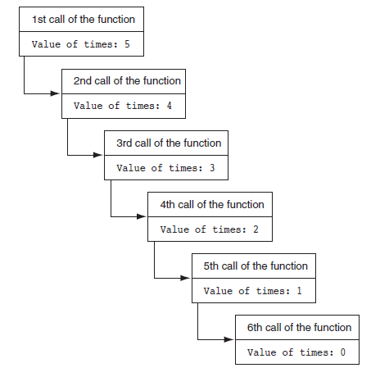
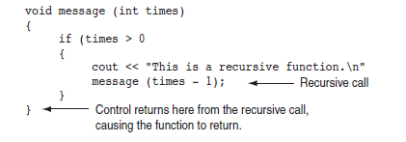
Recursion – Example (2)

Slide 4
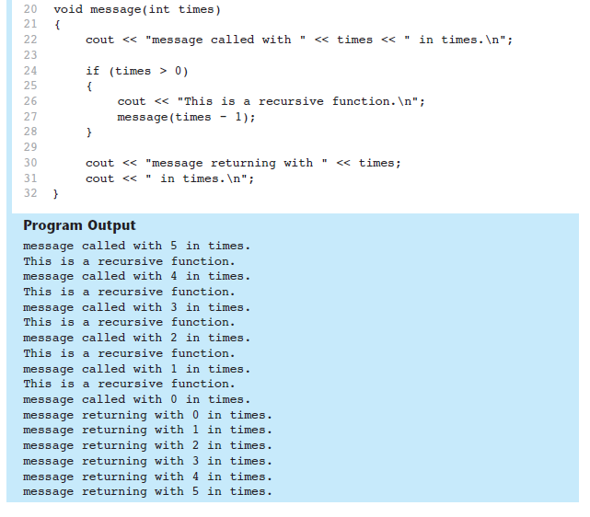
Recursion – Example (3)

Slide 5
Concept: Recursion
In general, a recursive function works like this:
If the problem can be solved now, without recursion, then the function solves it and returns (base case)
Base Case: Condition when recursion stops.
If the problem cannot be solved now, then the function reduces it to a smaller but similar problem and calls itself to solve the smaller problem (recursive case)
Recursive Case: Breaking the problem into smaller instances.
Important Rule: Every recursion must converge to a base case.

Slide 6
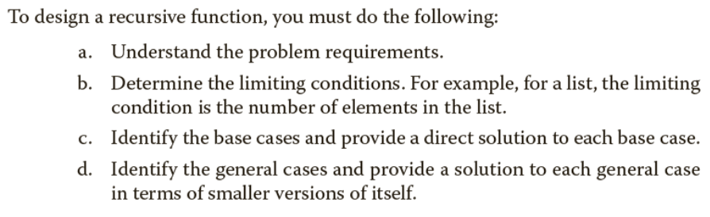
Concept - Recursion
Each recursion call gets its own stack frame
Stack grows till it reaches base case, then it unwinds

Slide 7
Concept - Recursion
Always think Base Case First.
Trust recursion: Assume the smaller problem is already solved.
Visualize Call Stack behavior.

Slide 8
Concept - Recursion
Mistakes | Example
No base case | Infinite recursion
Incorrect base case | Wrong output
Missing return | Stack overflow

Slide 9
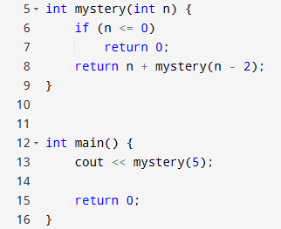
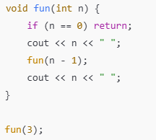
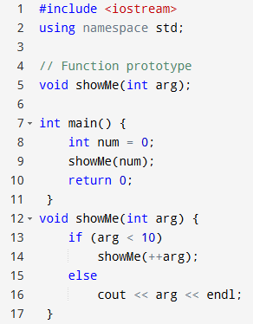
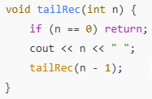
Concept - Recursion
Make a call stack for each function call and determine the output

Slide 10
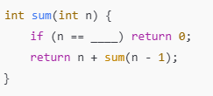

Concept - Recursion
Fill in the blanks to complete the recursion
Identify the error

Slide 11
Practice Questions
Factorial

Slide 12

Factorial
The base case for recursion can be solved without recursion.
We can write the expression for the recursive part as well.

Slide 13
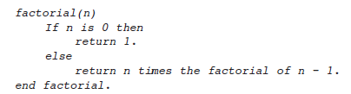
Factorial pseudocode
Try converting the following pseudocode to C++ code

Slide 14
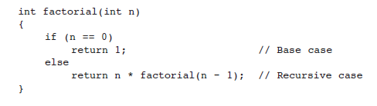
Factorial implementation

Slide 15
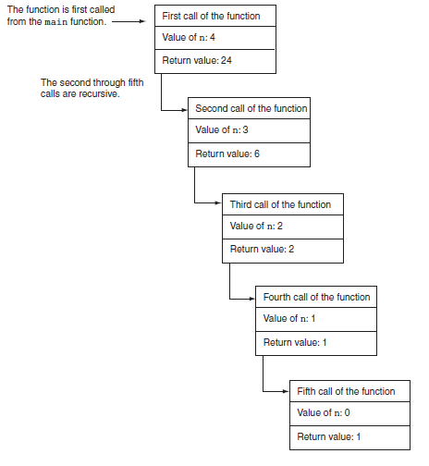
Factorial dry run

Slide 16
Practice Questions
Fibonacci Series

Slide 17


Fibonacci Series
Can you figure out the base case? recursive case?
Series is:
Series looks like this:

Slide 18
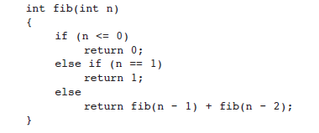
Fibonacci Series

Slide 19
Practice Questions
Recursion in linked lists

Slide 20
Counting Nodes in a Linked List
Iterative
Recursive
Can you figure out the base case? recursive case?
Can you write a pseudocode?

Slide 21
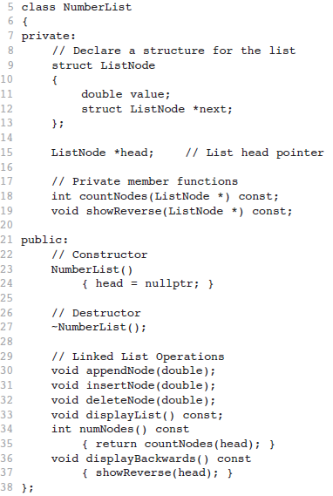
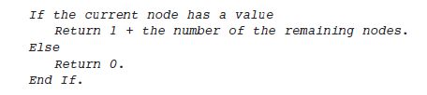
Counting Nodes in a Linked List
Pseudocode

Slide 22
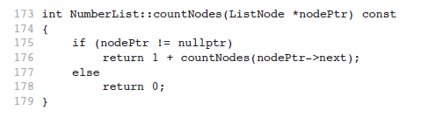
Counting Nodes in a Linked List
Pseudocode

Slide 23
Practice Questions
Printing singly linked list in reverse

Slide 24
Printing Linked List in reverse
Is there an iterative way to print a singly linked list in reverse?
Recursive way?
Recap:
If the problem can be solved now, without recursion, then the function solves it and returns (base case)
If the problem cannot be solved now, then the function reduces it to a smaller but similar problem and calls itself to solve the smaller problem (recursive case)
Keeping this in mind
Base case -> 1 node
Recursive case -> reaching that 1 base case node
How will we iterate over the linked list

Slide 25
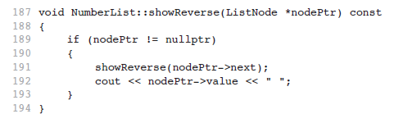
Printing singly linked list in reverse

Slide 26
Practice Question
Recursive Binary Search

Slide 27
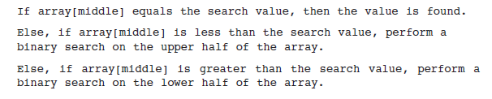
Recursive Binary Search
Values in the array should be sorted.

Slide 28
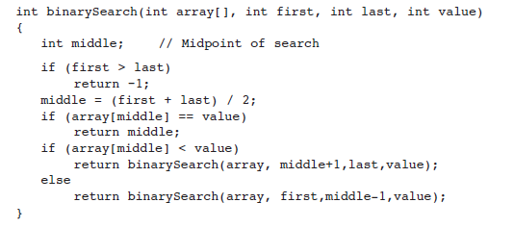
Recursive Binary Search
Returns index if found, otherwise returns -1.

Slide 29
Binary recursion
When an algorithm makes two recursive calls, it is said to use binary recursion.

Slide 30
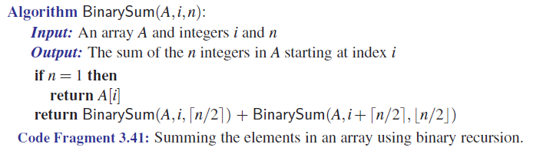
To keep things simple, assume n is a power of 2

Slide 31
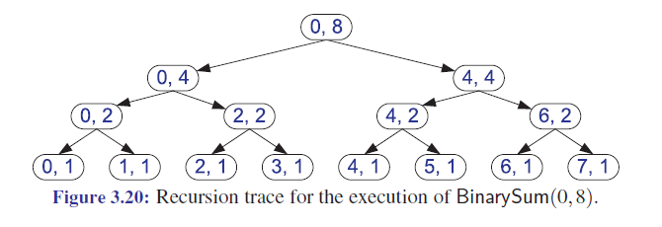

Slide 32
Multiple recursion
Generalizing from binary recursion, we use multiple recursion when a function may make multiple recursive calls, with that number potentially being more than two.

Slide 33
Lecture content adapted from Michael T. Goodrich textbook, chapter 3 & Tony Gaddis textbook chapter 19.

Slide 34
Practice Questions
Using recursion to count characters

Slide 35
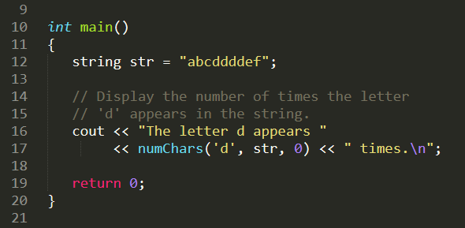
Count characters
Can you figure out the base case? recursive case?

Slide 36
Count characters
Can you figure out the base case? recursive case?
What are the possibilities when processing each character of the string?

Slide 37
Count characters
Can you figure out the base case? recursive case?
What are the possibilities when processing each character of the string?
Char doesn’t match
Char matches
Anything else?

Slide 38
Count characters
Can you figure out the base case? recursive case?
What are the possibilities when processing each character of the string?
Char doesn’t match
Char matches
Anything else? End of string

Slide 39
Count characters
What are the possibilities when processing each character of the string?
Char doesn’t match -> recursive as we still have to search the rest of the string
Char matches -> recursive as we still have to search the rest of the string
Anything else? End of string -> base case, no more characters to search
Function parameters:
search: the character to be searched for and counted
str: a string object containing the string to be searched
subscript: the starting subscript for the search

Slide 40
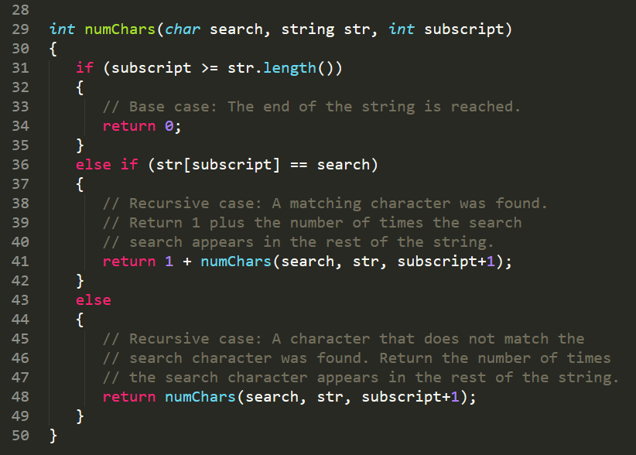
Count characters

Slide 41
Any Questions?

